Slide 1

Part 2: AI Search Algorithms (Making Decisions)
AI search algorithms are methods used to find solutions to problems by exploring a set of possible options.

Slide 2







Search Problems
A search problem consist of:
A State space/Search Space
A conceptual representation of all possible states that a problem can be in.
A map of all different scenarios an agent might encounter while trying to solve a problem.
A successor function (Actions, Costs)
Actions that lead to the goal.
Move Right
Move UP
A start state and a goal state(s)
Starting and ending of the problem
A solution is a sequence of actions (a plan) which transforms the start state to a goal state

Slide 3
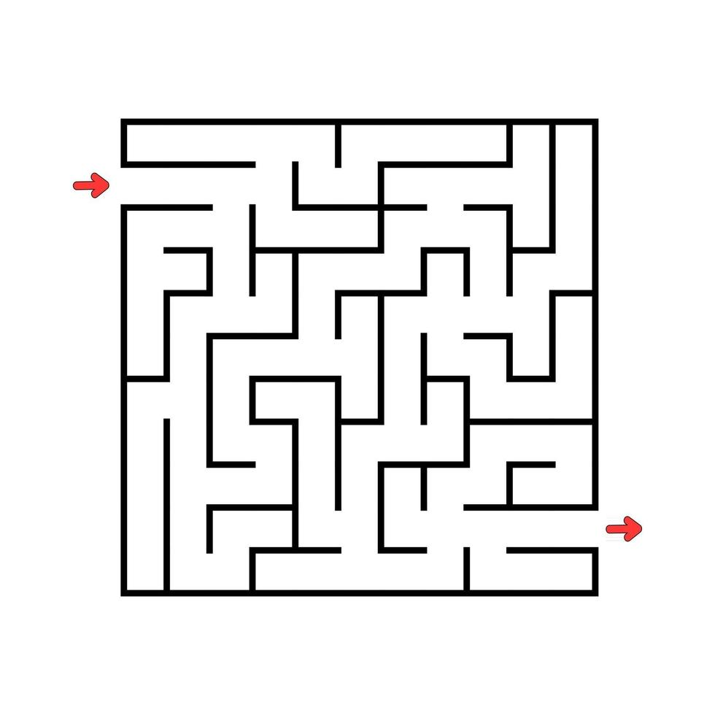
What is in the search space/ state space?
The world state includes every last detail of the environment
A search state keeps only the details needed for planning (abstraction)
Problem: Pathing
States: location/Position (X,Y)
Actions: NSEW/ UP, Left, Right, Down
Successor: update location
Start State: is (x,y) = START
Goal test: is (x,y)=END

Slide 4
Search Algorithms Properties
Complete: Guaranteed to find a solution if one exists?
Optimal: An optimal search algorithm finds the best possible solution, typically the one with the lowest cost or shortest path, among all possible solutions.?
Time Complexity: The amount of time it takes for the algorithm to find a solution. It is often expressed in terms of the number of nodes expanded during the search.
Space Complexity: The amount of memory or storage space required by the algorithm to execute. It is often measured in terms of the maximum number of nodes stored in memory at any point during the search.
Notes:
Search algorithms in AI possess various properties that determine their behavior and efficiency in finding solutions to problems. Here are some key properties:

Slide 5
Search Algorithms Properties
Admissibility: An admissible heuristic is one that never overestimates the cost to reach the goal. In informed search algorithms like A*, an admissible heuristic ensures that the algorithm finds the optimal solution.
Consistency (Monotonicity): A heuristic is consistent if it always gives a good estimate of how much it costs to get from a current point to the goal, even when moving to the next point. Consistency is important because it helps algorithms make reliable decisions when searching for solutions.
Notes:
Search algorithms in AI possess various properties that determine their behavior and efficiency in finding solutions to problems. Here are some key properties:

Slide 6
Search Algorithms Properties
Cartoon of search tree:
b is the branching factor
m is the maximum depth
solutions at various depths
Number of nodes in entire tree?
1 + b + b² + …. b^{m} = O(b^{m})
1 node
b nodes
b² nodes
m tiers
b^{m} nodes
Notes:
Search algorithms in AI possess various properties that determine their behavior and efficiency in finding solutions to problems. Here are some key properties:

Slide 7
AI Search Algorithms
Uninformed Search Algorithms
Informed Search Algorithms.
Adversarial Search Algorithms.
Local Search Algorithms

Slide 8
Uninformed Search Algorithms
Uninformed Search Algorithms (Blind Search) - is a class of search algorithms used to explore a problem space without any additional information beyond the problem definition.
Uninformed search methods rely solely on the structure of the search space and do not possess any knowledge about the likelihood or cost of reaching the goal.
The main characteristic is they systematically explore the search space without making any assumptions about the location of the goal state or the relative cost of reaching it.

Slide 9
Examples Uninformed Search Algorithms
Breadth-First Search (BFS)
Depth-First Search (DFS)
Uniform-Cost Search (UCS)

Slide 10
Breadth-First Search (BFS)
BFS explores the search space level by level, expanding all the nodes at a given depth before moving on to the next level. This ensures that the shortest path to the goal state is found in terms of the number of edges traversed.
Example
Consider a simple graph representing a network of cities connected by roads. You want to find the shortest path from one city to another.
How it works?
BFS would start from the initial city and explore all neighboring cities first before moving to the next level of cities. It continues this process until it finds the destination city.
BFS guarantees the shortest path between the initial and destination cities in terms of the number of edges traversed.
Notes:
BFS explores a problem step by step, starting with the closest options and moving outward. It checks all the possibilities at each level before moving to the next. This method guarantees finding the shortest path because it looks at nearby options first and expands from there, ensuring the least number of steps needed to reach the goal.

Slide 11
Breadth-First Search (BFS)
B
B
A
B
C
D
F
E
G
E
E
D
D
A
A
G
G
C
C
F
F
Notes:
BFS explores a problem step by step, starting with the closest options and moving outward. It checks all the possibilities at each level before moving to the next. This method guarantees finding the shortest path because it looks at nearby options first and expands from there, ensuring the least number of steps needed to reach the goal.

Slide 12

Depth-First Search (BFS)
DFS explores the search space by traversing as far as possible along a branch before backtracking. It goes as deep as possible along each branch before exploring other branches. DFS may not find the shortest path to the goal and can get stuck in infinite loops in the presence of cycles.
Example
Consider a maze where you're searching for a path from the entrance to the exit.
How it works?
DFS would start exploring one path from the entrance and continue going deeper and deeper until it reaches a dead-end or the exit. If it reaches a dead-end, it backtracks to the most recent decision point and explores another path.
DFS does not guarantee the shortest path and may get stuck in infinite loops if the search space contains cycles.
Notes:
BFS explores a problem step by step, starting with the closest options and moving outward. It checks all the possibilities at each level before moving to the next. This method guarantees finding the shortest path because it looks at nearby options first and expands from there, ensuring the least number of steps needed to reach the goal.

Slide 13
Depth-First Search (BFS)
B
E
D
A
G
C
F
Notes:
BFS explores a problem step by step, starting with the closest options and moving outward. It checks all the possibilities at each level before moving to the next. This method guarantees finding the shortest path because it looks at nearby options first and expands from there, ensuring the least number of steps needed to reach the goal.

Slide 14
Uniform-Cost Search (UCS)
search algorithm used to find the lowest-cost path from a starting point to a goal state in a weighted graph
Example
Consider a simple graph representing a network of cities connected by roads. You want to find the shortest path from one city to another.
How it works?
BFS would start from the initial city and explore all neighboring cities first before moving to the next level of cities. It continues this process until it finds the destination city.
BFS guarantees the shortest path between the initial and destination cities in terms of the number of edges traversed.
Notes:
BFS explores a problem step by step, starting with the closest options and moving outward. It checks all the possibilities at each level before moving to the next. This method guarantees finding the shortest path because it looks at nearby options first and expands from there, ensuring the least number of steps needed to reach the goal.

Slide 15
Uniform-Cost Search (UCS)
Search algorithm used to find the lowest-cost path from a starting point to a goal state in a weighted graph.
UCS explores the graph by expanding nodes with the lowest path cost from the start node. It gradually builds the solution by considering paths with increasing costs, ensuring that it finds the lowest-cost path to the goal.
Notes:
BFS explores a problem step by step, starting with the closest options and moving outward. It checks all the possibilities at each level before moving to the next. This method guarantees finding the shortest path because it looks at nearby options first and expands from there, ensuring the least number of steps needed to reach the goal.

Slide 16
Uniform-Cost Search (UCS)
Example: Consider a map where nodes represent cities and edges represent roads with associated travel costs. UCS would find the lowest-cost route from one city to another, considering the cost of each road segment.
Notes:
BFS explores a problem step by step, starting with the closest options and moving outward. It checks all the possibilities at each level before moving to the next. This method guarantees finding the shortest path because it looks at nearby options first and expands from there, ensuring the least number of steps needed to reach the goal.

